Slide 1




NREGA Data Analysis
Insights and Trends in the National Rural Employment Guarantee Act Implementation
Presented by - Aditya Kumar Singh

Slide 2
Introduction
It is a government initiative to provide rural employment and it is a guarantee of wage employment to rural households.
01 - OVERVIEW OF NREGA
02 - OBJECTIVES OF THE ANALYSIS
The main objective of the Analysis is to gain insights into NREGA implementation and Identifying trends and disparities

Slide 3
Problem Statement
How effective is NREGA in providing employment?
Regional disparities in implementation
Budget utilization and its correlation with employment generation
Factors contributing to work completion
Data-driven insights for policy optimization

Slide 4
Dataset Description
Source: Official government records
Description: Implementation data across states and districts
Key Variables: State and district names, Number of job cards issued and active, Number of workers (total, active, SC, ST), Budget and expenditure details, Work completion statistics

Slide 5
Exploratory Data Analysis Using Tableau

Slide 6
Regional Disparities in NREGA Job Card Issuance
Analysis
`Job cards issued across states and districts
Visualization: Heatmap of disparities
Insights: Highlighting regions with significant disparities

Slide 7
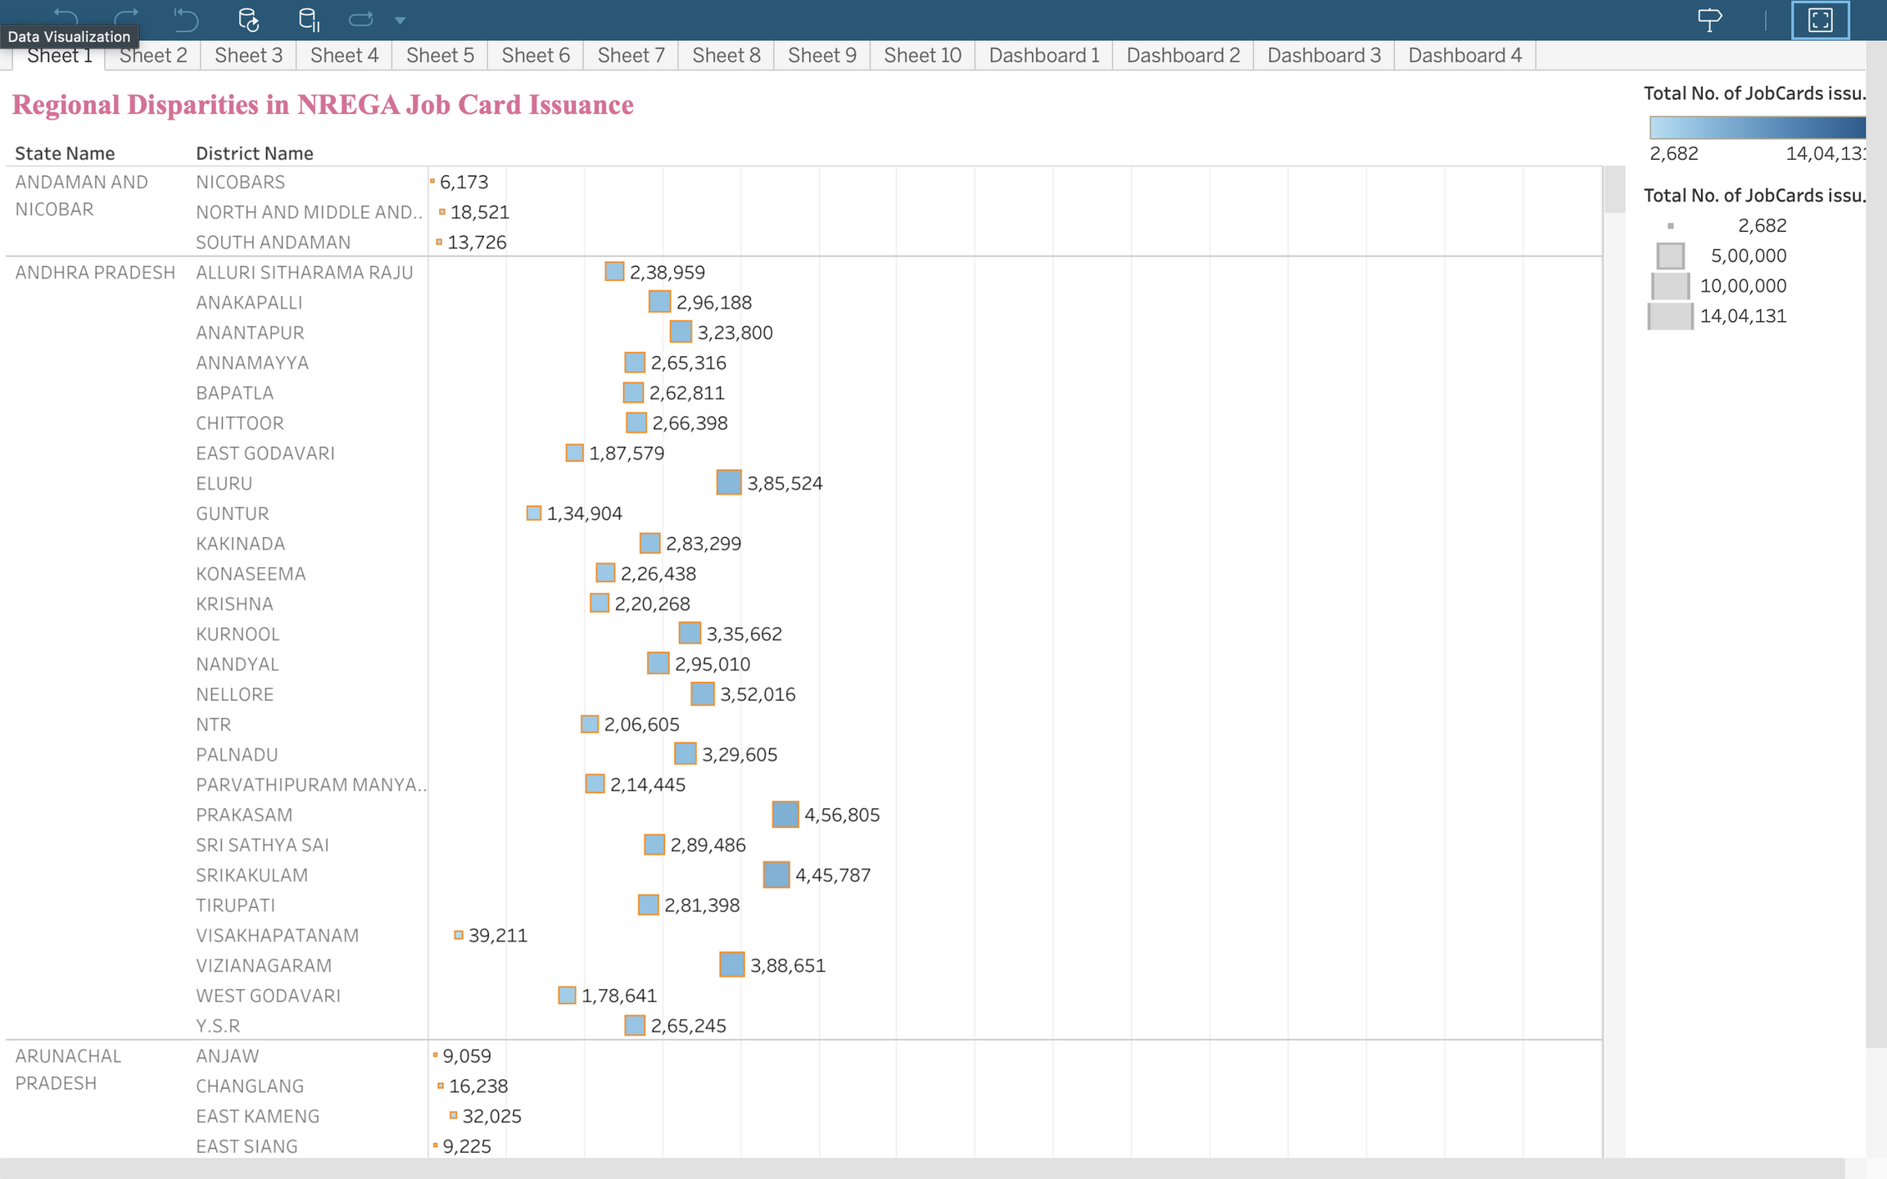

Slide 8
State-wise NREGA Employment Analysis
Analysis
Total job cards issued, workers registered, active workers
Visualization: Bar chart comparison
Key Findings: Employment trends across states

Slide 9
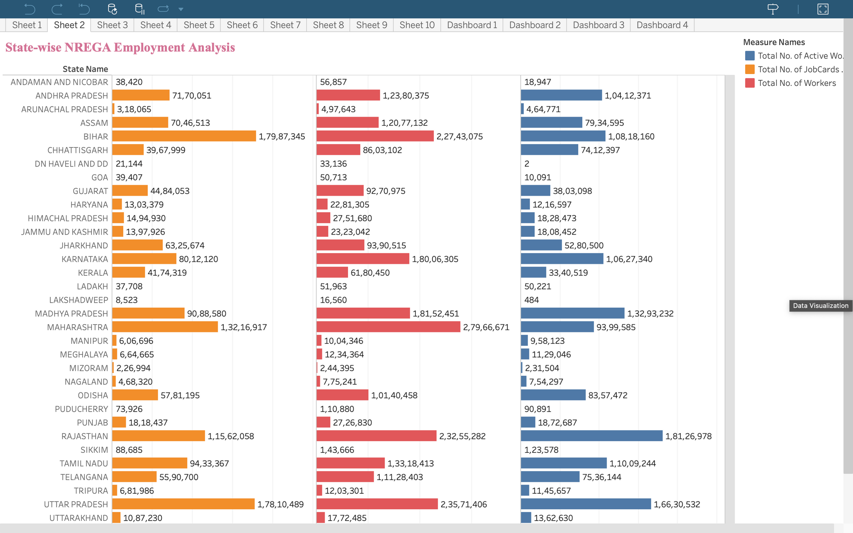

Slide 10
Budget Utilization vs. Employment Generation
Analysis
Correlation between budget allocation and employment
Visualization: Scatter plot
Insights: How budget impacts employment generation

Slide 11
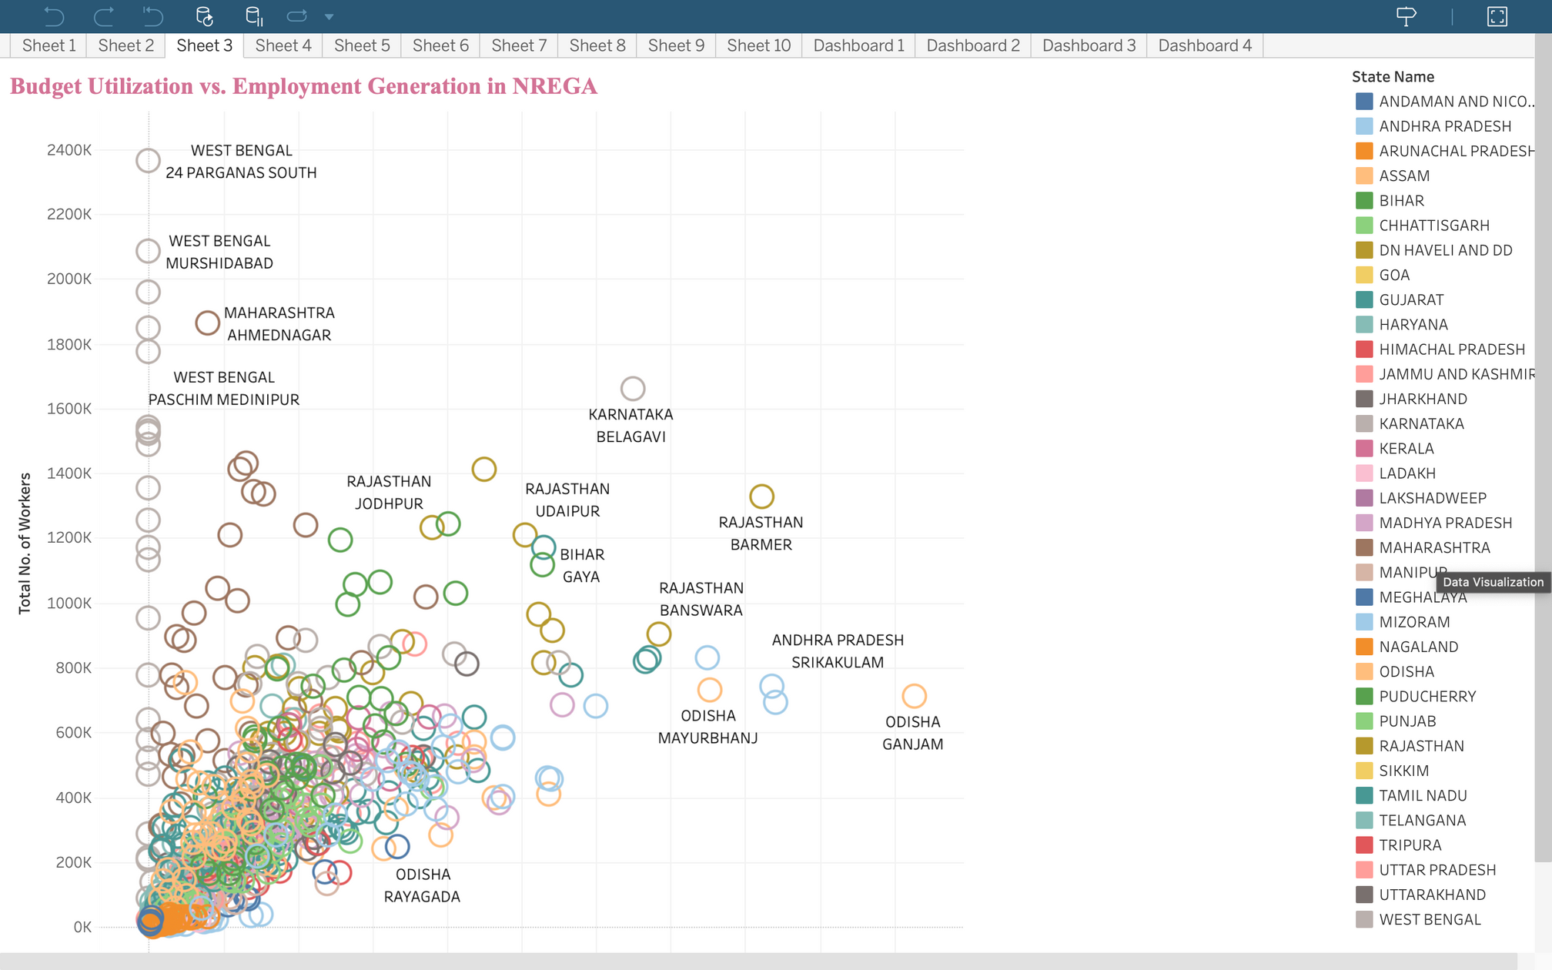

Slide 12
Employment Provided to SC, ST, and Women
Analysis
Persondays of employment for SC, ST, and women
Visualization: Stacked bar chart
Insights: Employment trends among marginalized groups

Slide 13
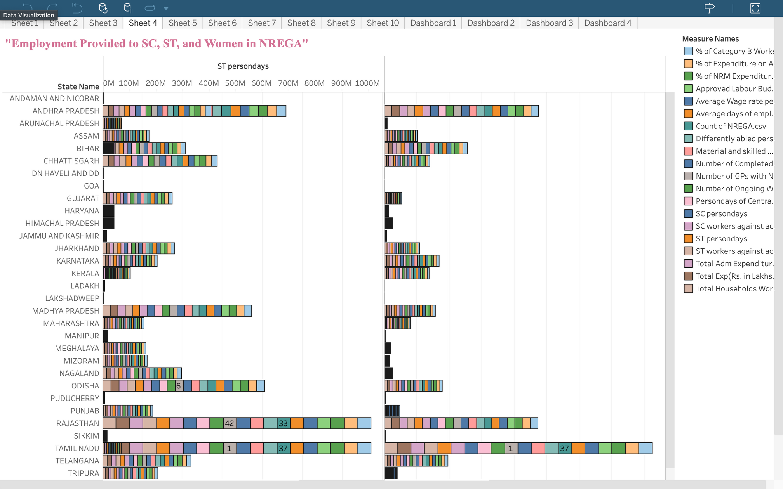

Slide 14
Comparison of Average Employment Days and Wage Rate
Analysis
Comparison of average employment days and wage rate across states
Visualization: Dual-axis chart
Insights: Trends in employment days and wage rates

Slide 15
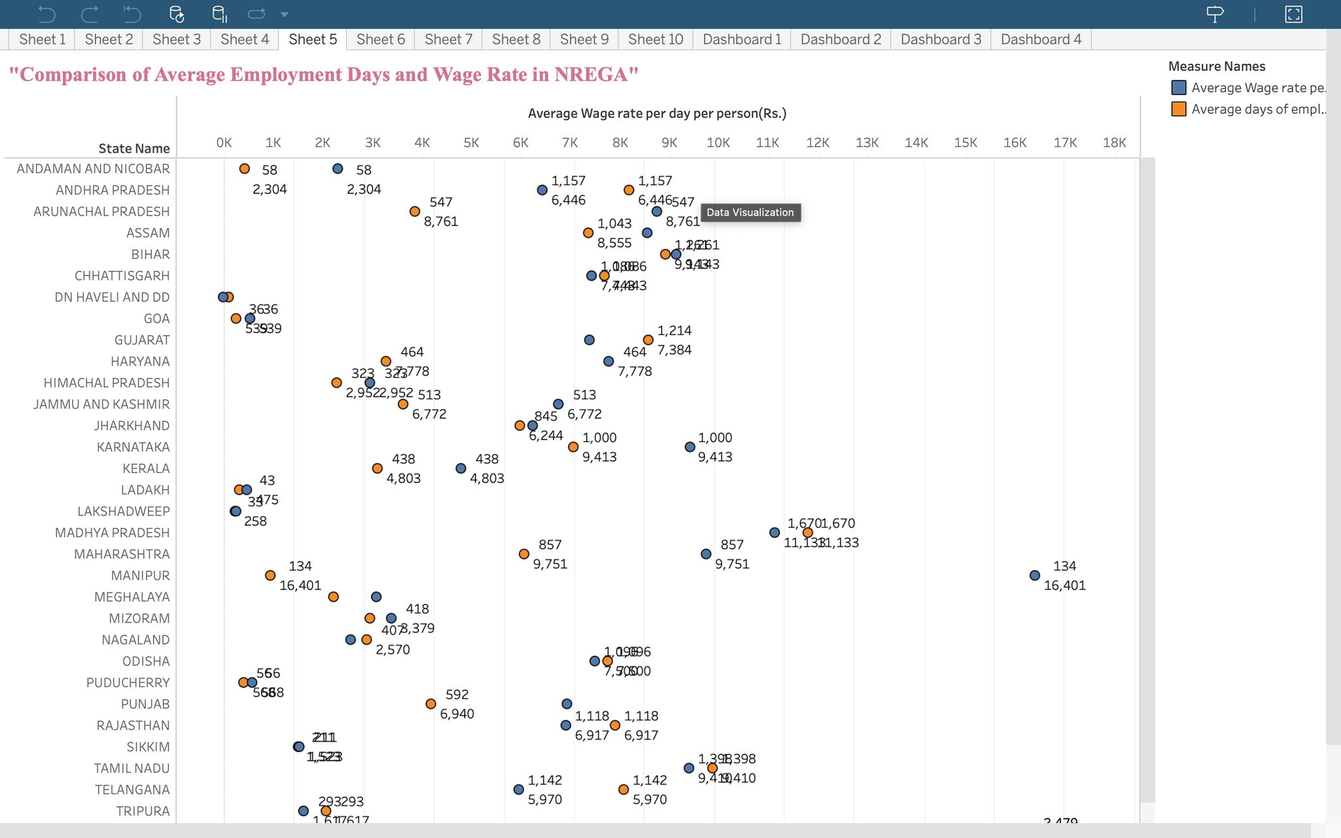

Slide 16
Comparison of Ongoing and Completed NREGA Works
Analysis
Status of ongoing vs. completed works
Visualization: Side-by-side bar chart
Insights: Work completion trends

Slide 17
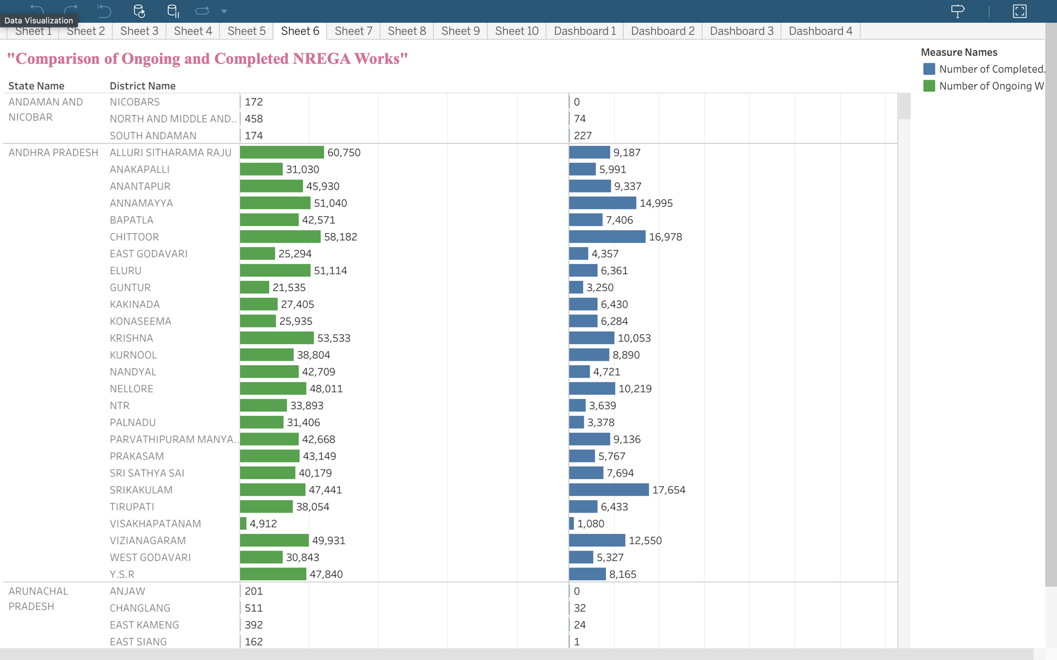

Slide 18
Expenditure Breakdown by State
Analysis
Total expenditure, wages, material and skilled wages, administrative expenditure
Visualization: Stacked bar chart
Insights: Expenditure patterns across states

Slide 19
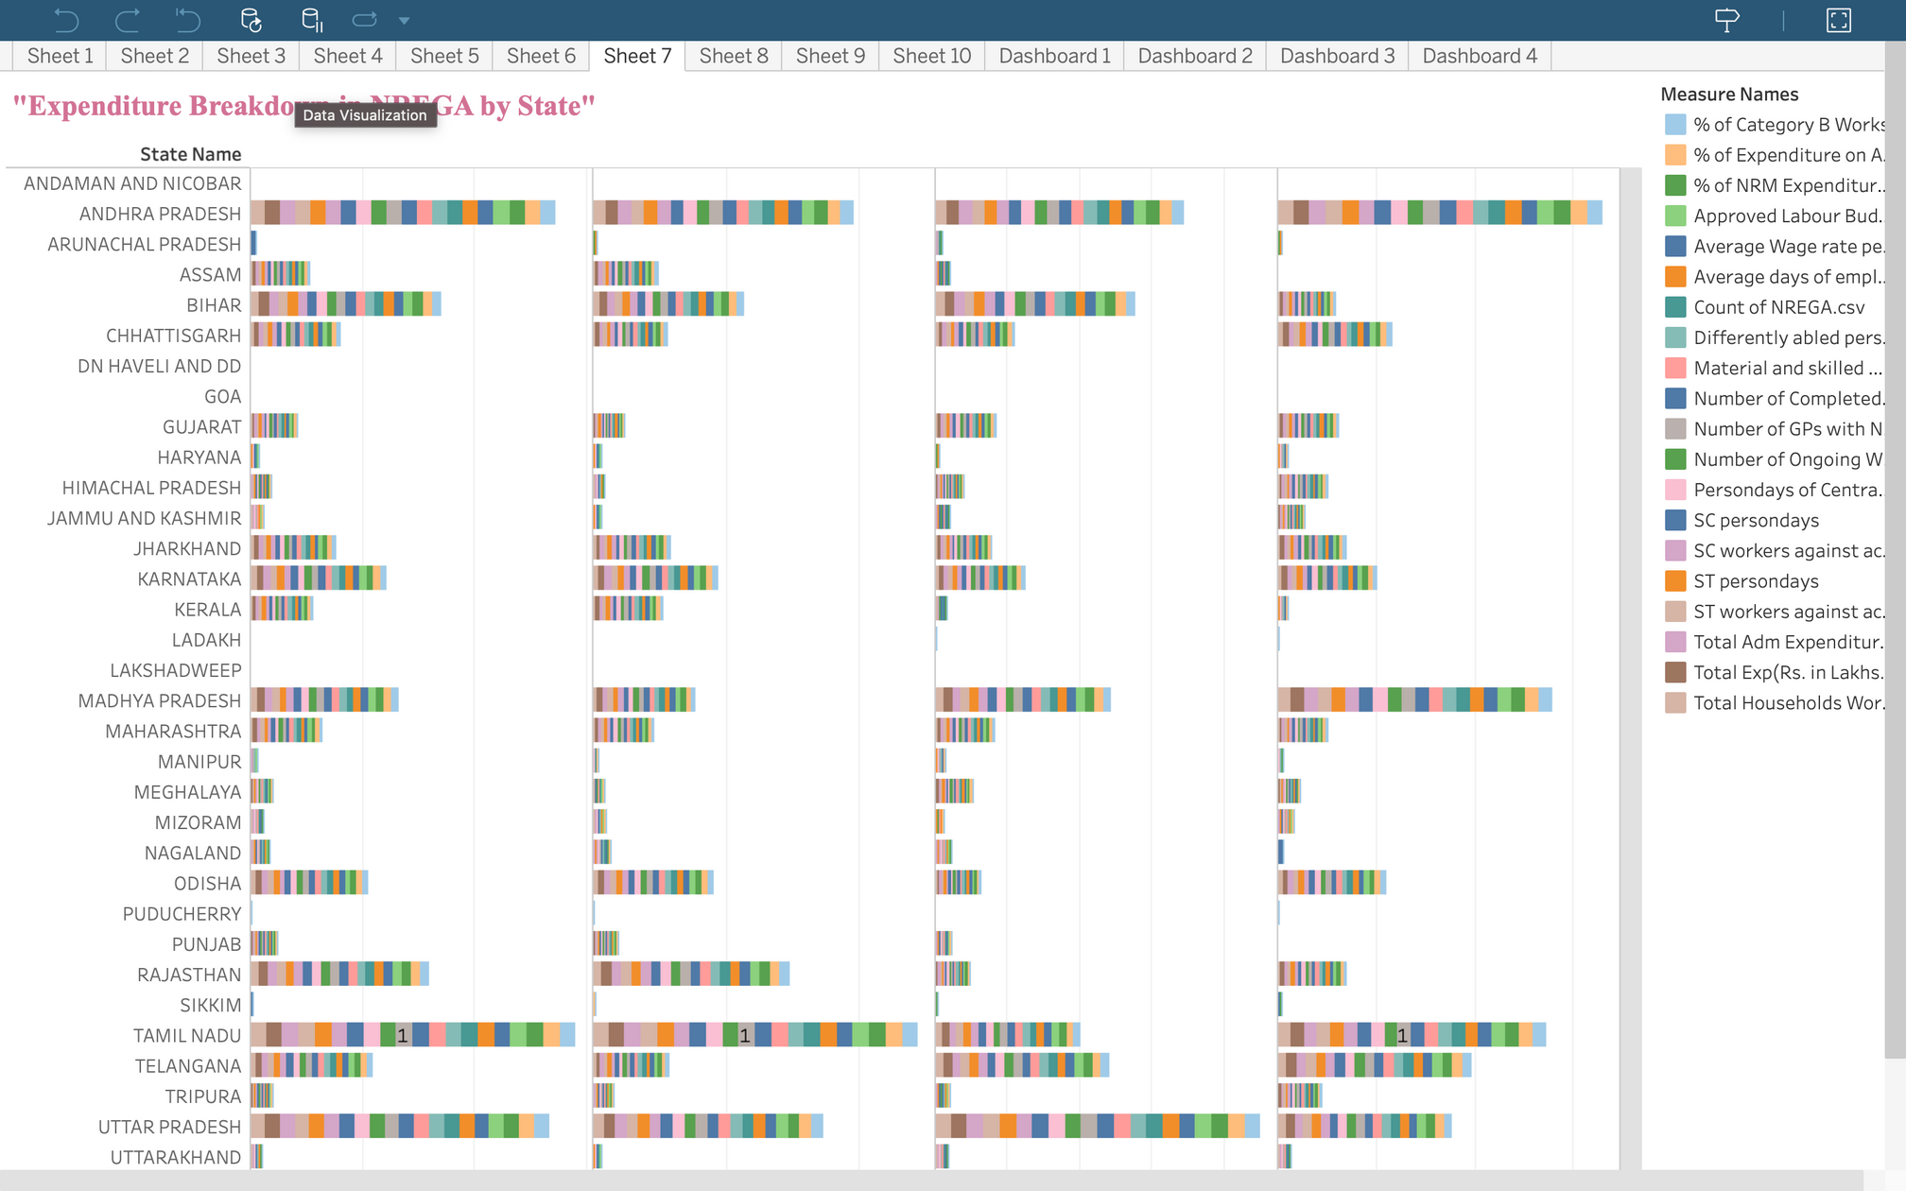

Slide 20
Percentage of NRM Expenditure by State
Analysis
Percentage of expenditure on Natural Resource Management
Visualization: Bar chart
Insights: NRM expenditure trends

Slide 21
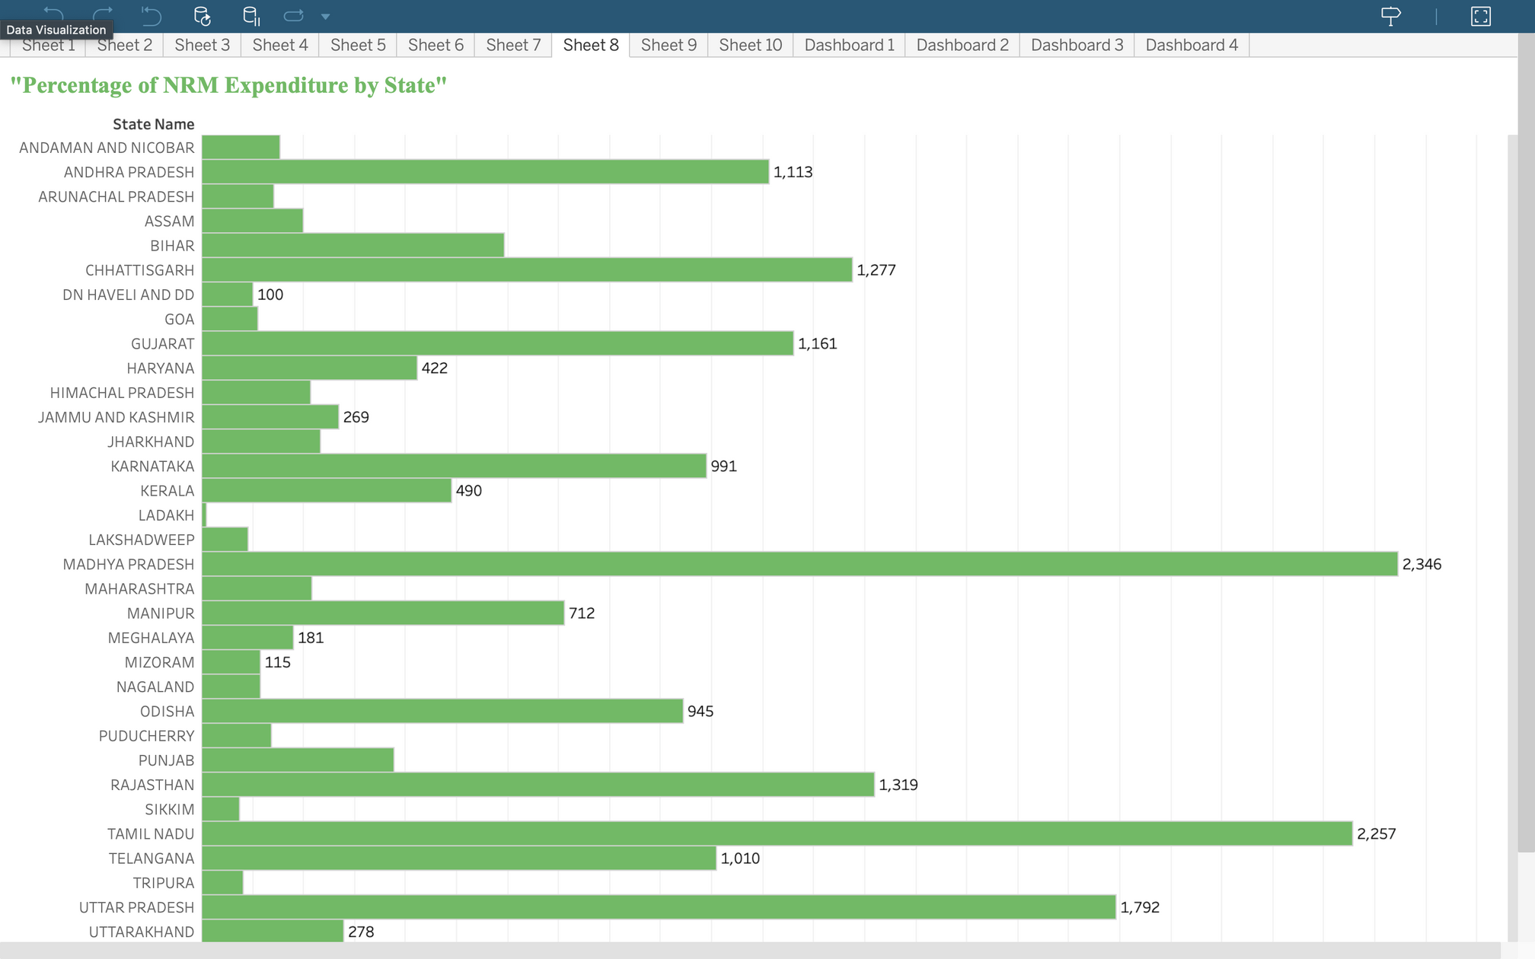

Slide 22
Percentage of Expenditure on Agriculture & Allied Works
Analysis
Percentage of expenditure on agriculture and allied activities
Visualization: Bar chart
Insights: Agriculture expenditure patterns

Slide 23
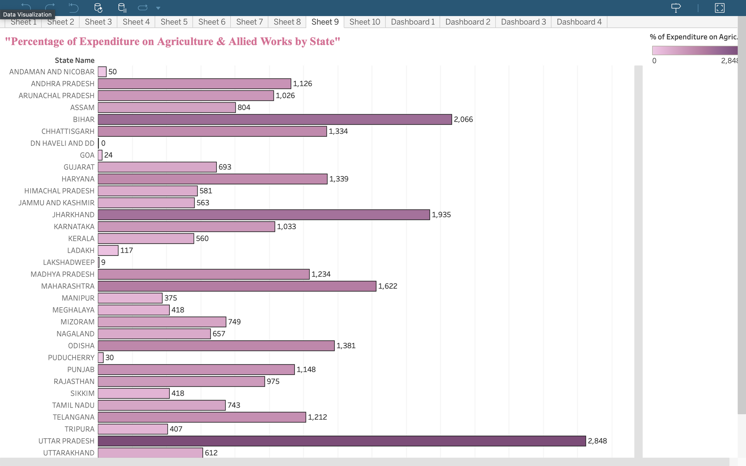

Slide 24
Relationship Between Total Workers and Average Wage Rate
Analysis
Relationship between the number of workers and wage rate
Visualization: Scatter plot
Insights: Correlation insights

Slide 25
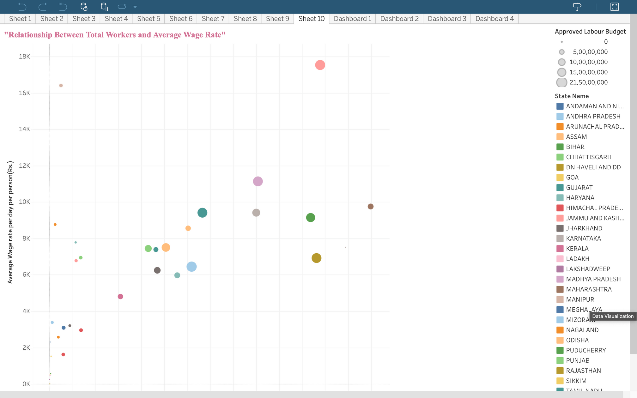

Slide 26
Dashboards

Slide 27
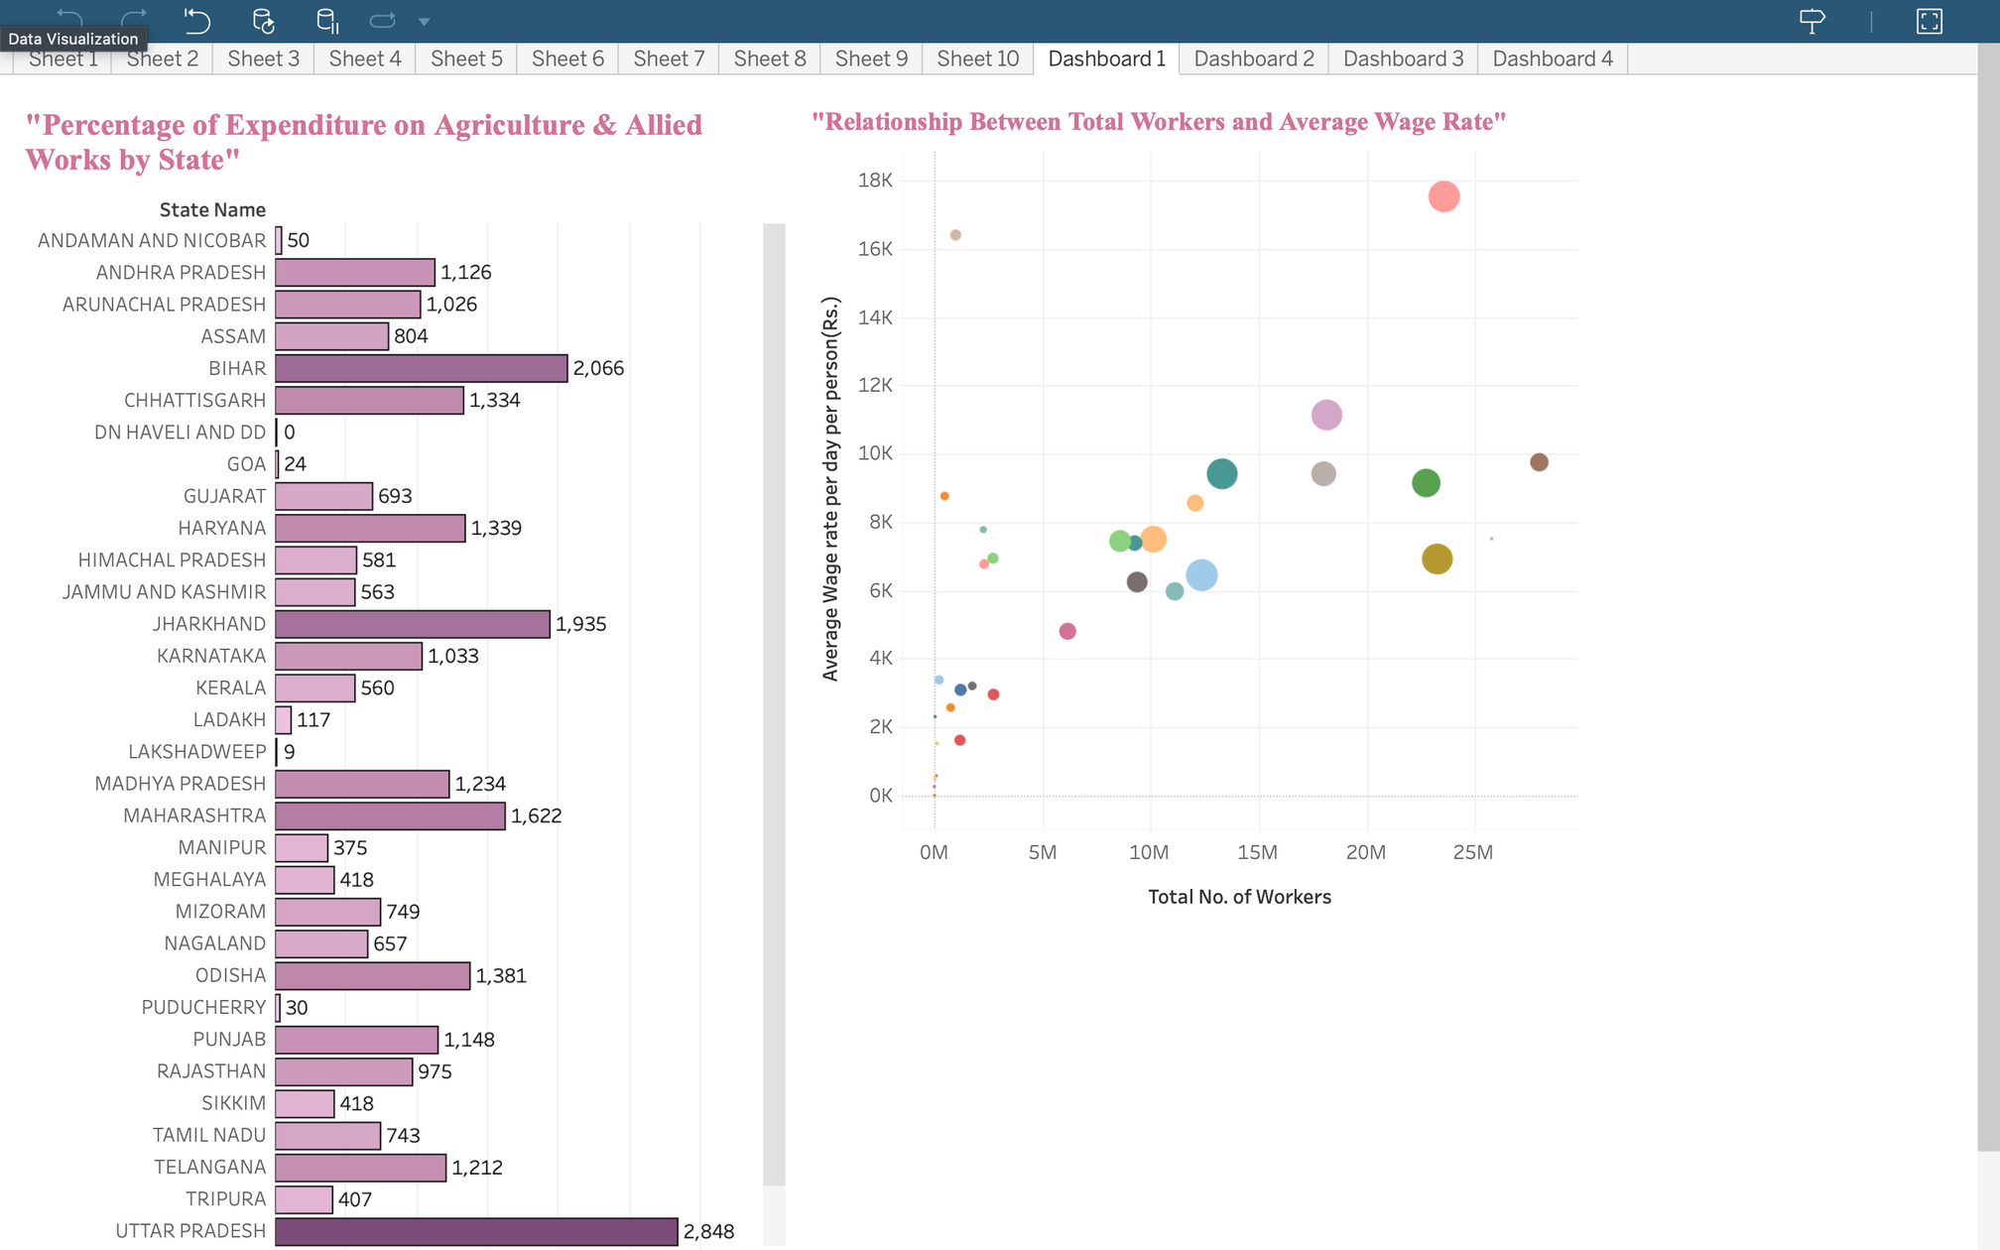

Slide 28
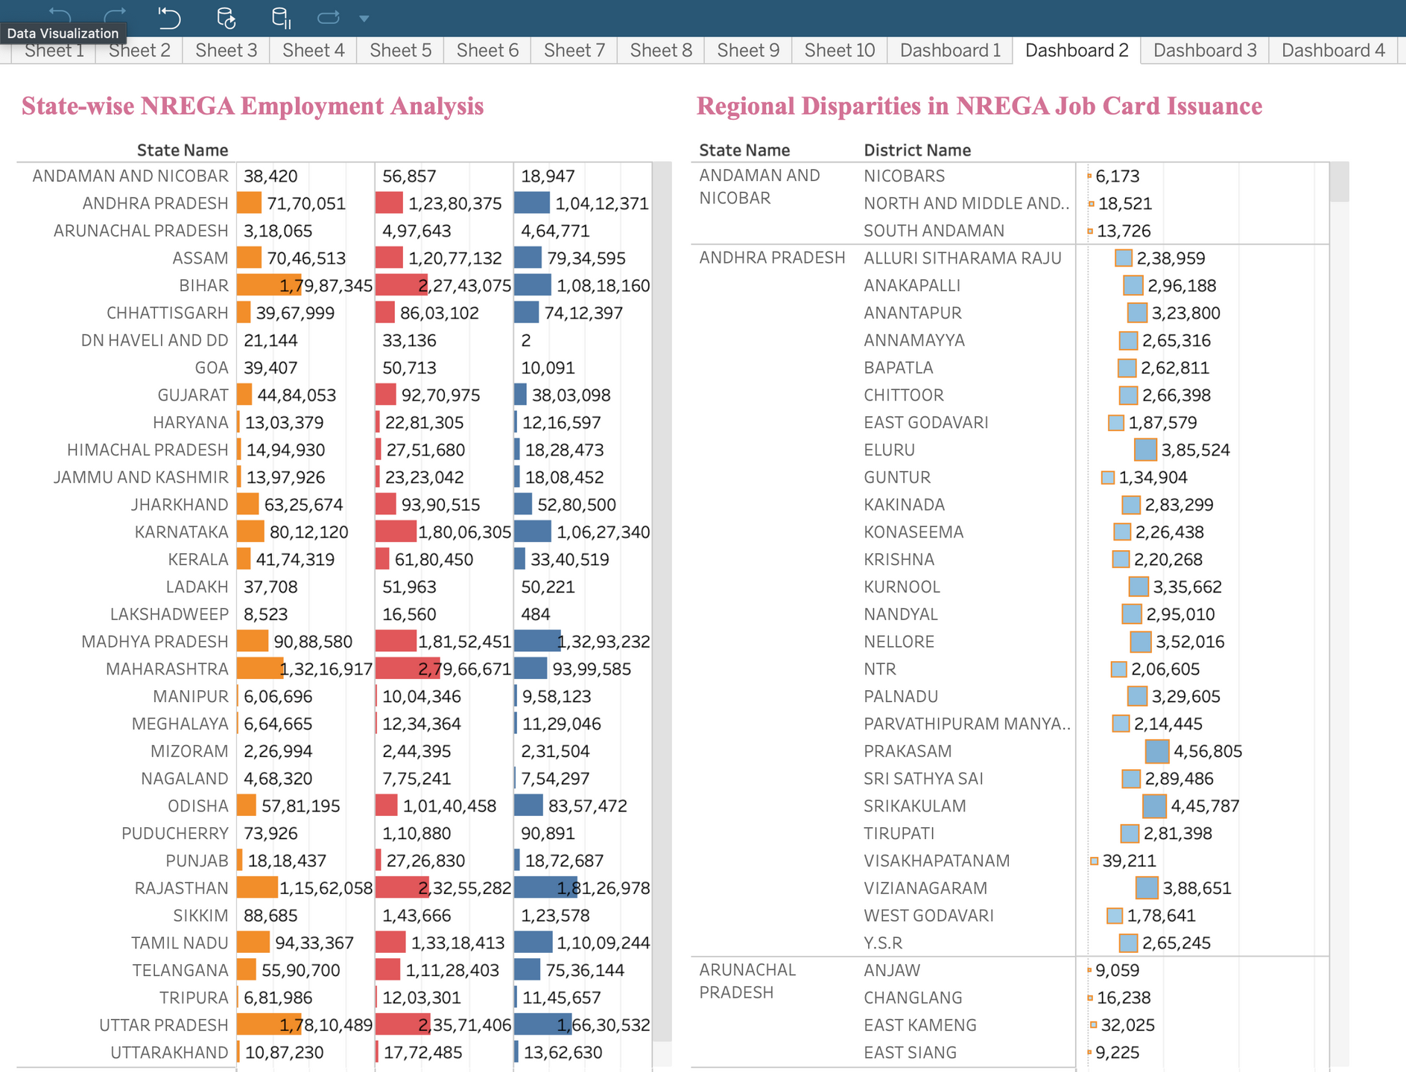

Slide 29
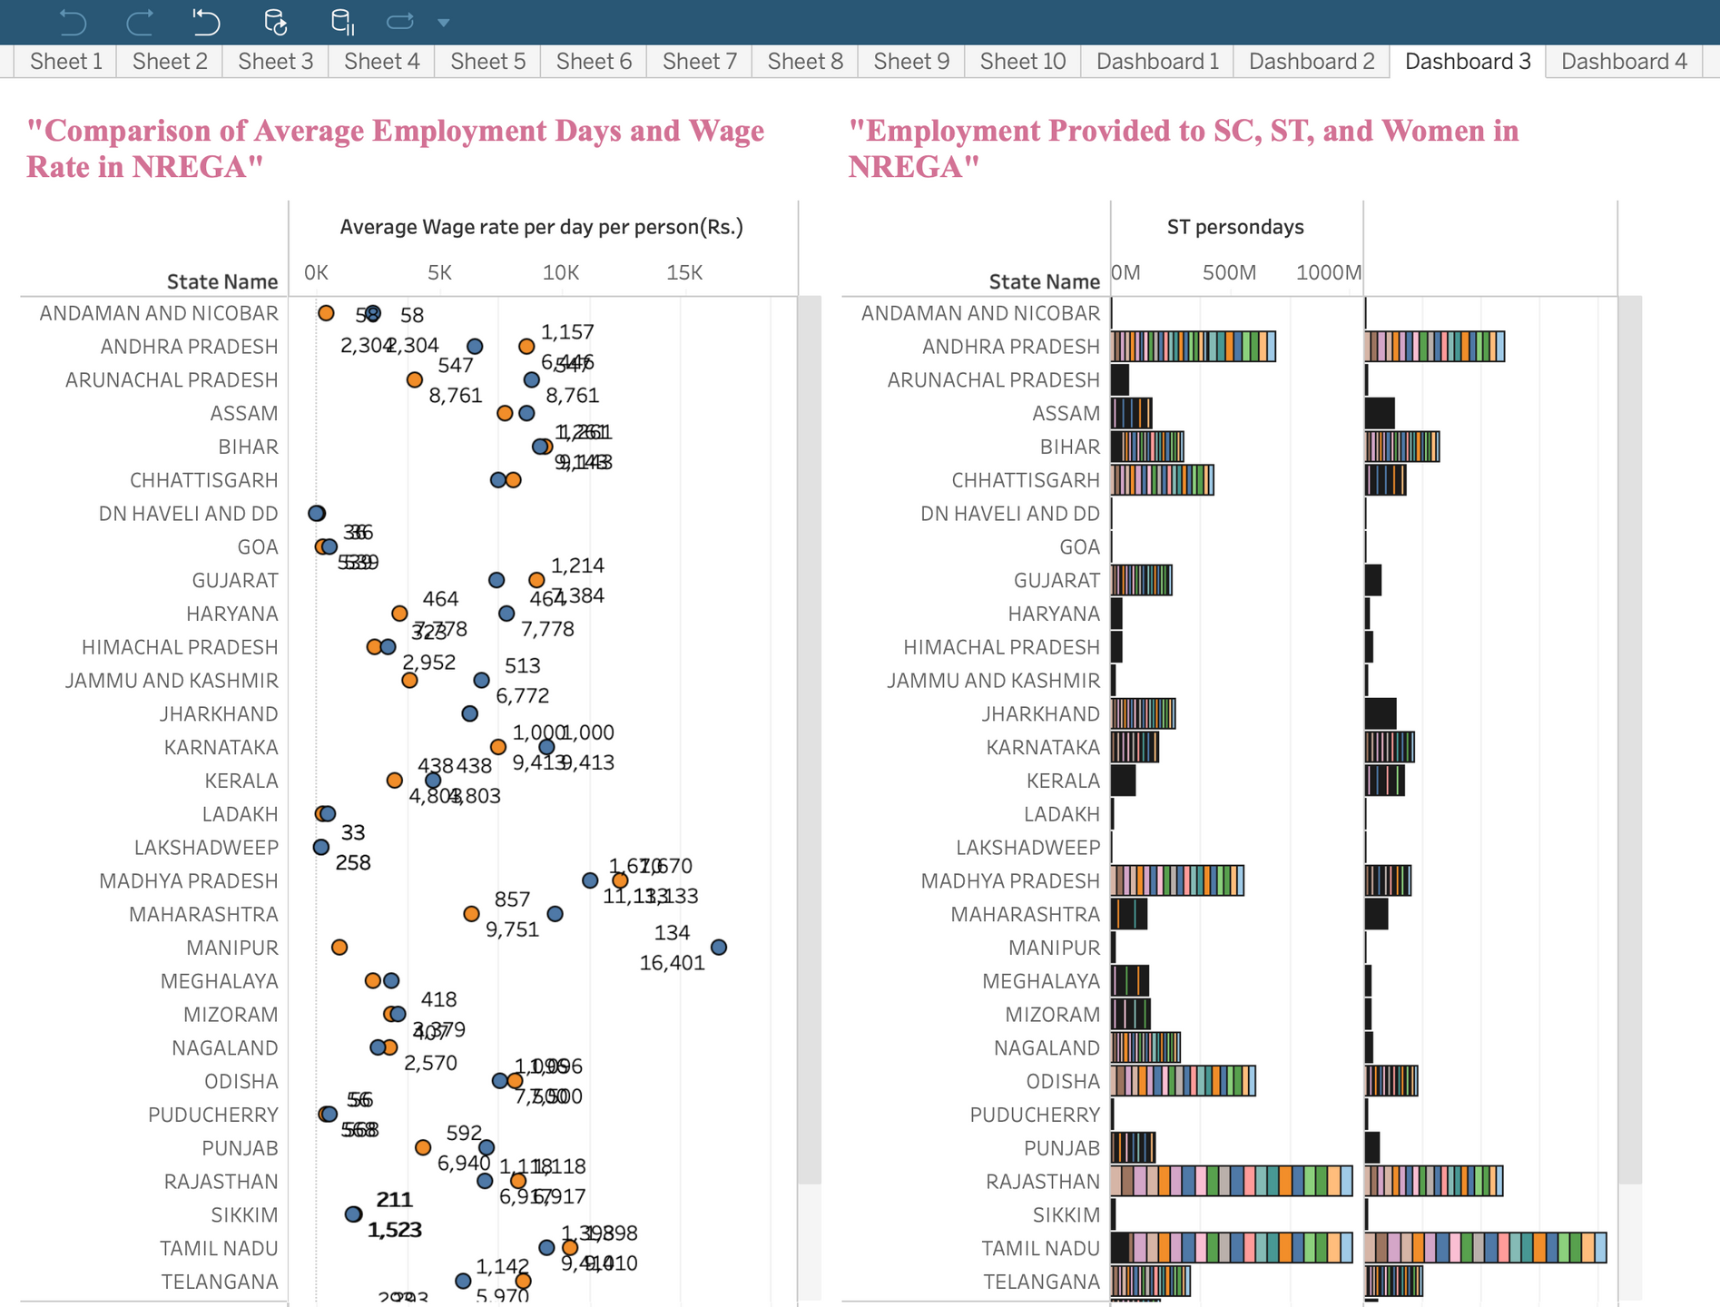

Slide 30
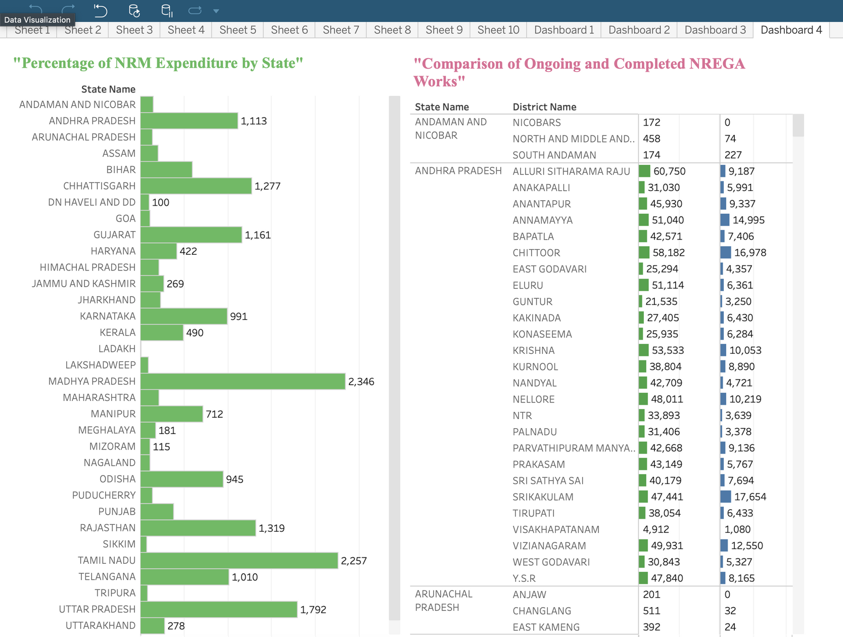

Slide 31
Conclusion
Summary of Key Findings
Effectiveness of NREGA in providing employment
Regional disparities in implementation
Correlation between budget utilization and employment generation
Employment trends among SC, ST, and women
Work completion status and expenditure patterns
Recommendations
Data-driven policy suggestions
Optimization strategies for NREGA impact

Slide 32
THANK YOU

